Slide 1

Car Dheko - Used Car Price Prediction

Slide 2
Objective
Imagine you are working as a data scientist in Car Dheko, your aim is to enhance the customer experience and streamline the pricing process by leveraging machine learning. You need to create an accurate and user-friendly streamlit tool that predicts the prices of used cars based on various features. This tool should be deployed as an interactive web application for both customers and sales representatives to use seamlessly.

Slide 3
Approach
Data Processing
Import and concatenate
Imported and concatenated data using Pandas and flattened the data as structured data for all columns to get data from Dictionaries.
Missing Value Treatment
missing values in data set treated by mean value and top value
Standardising Data Formats:
Values have been correctly formatted by removing KM, lakh, cr, Sec, mm, S in respective values
Removing Outliers:
Outliers removed from data set by dropping rows.

Slide 4
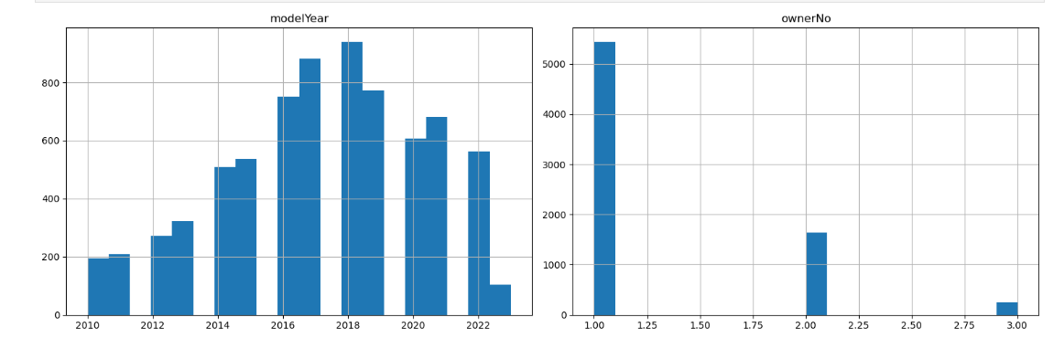
Approach
Exploratory Data Analysis (EDA)

Slide 5
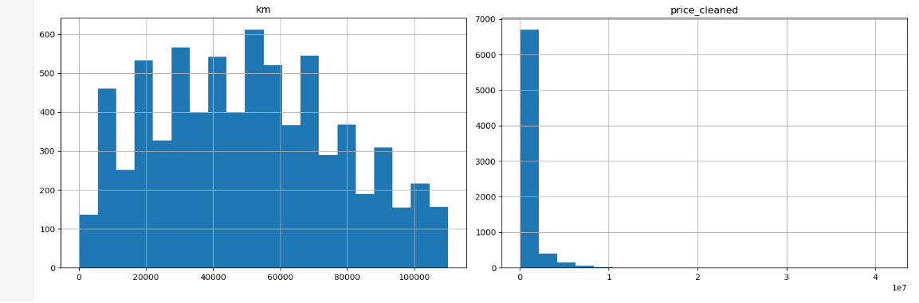
Approach
Exploratory Data Analysis (EDA)

Slide 6
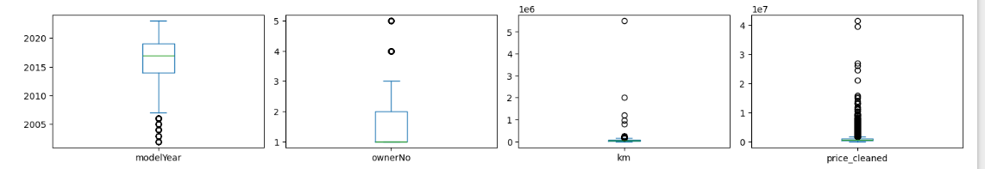
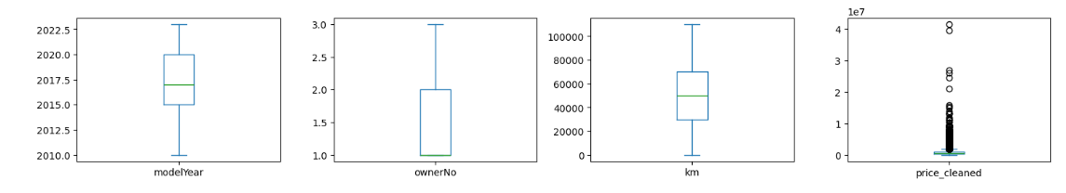
Approach
Exploratory Data Analysis (EDA)

Slide 7
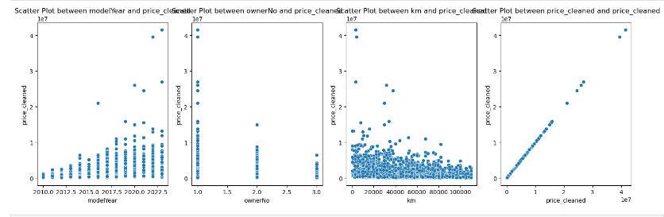
Approach
Exploratory Data Analysis (EDA)

Slide 8
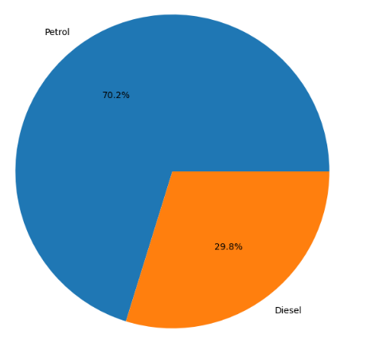
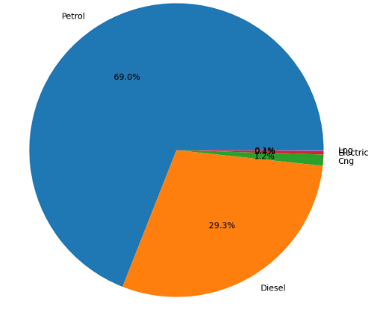
Approach
Exploratory Data Analysis (EDA)

Slide 9
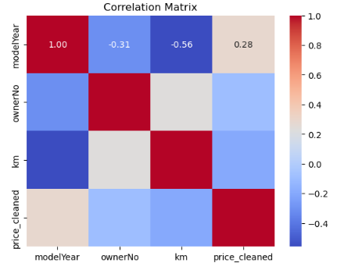
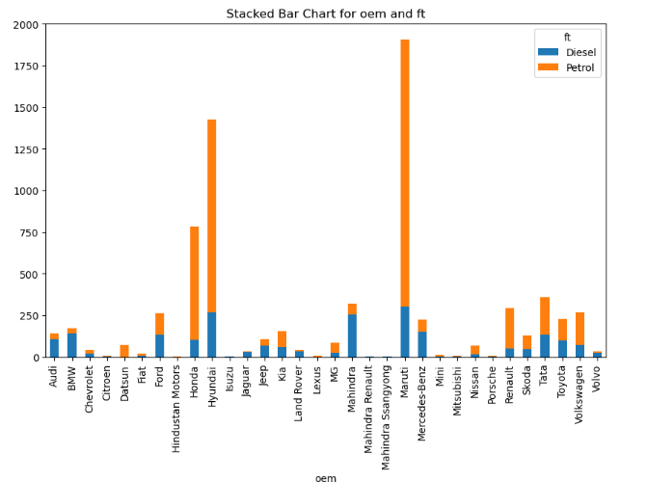
Approach
Exploratory Data Analysis (EDA)

Slide 10
Approach
Exploratory Data Analysis (EDA)

Slide 11
Approach
Exploratory Data Analysis (EDA)
Based on the EDA analysis Identified Outliers and removed from Data set and identified features for training.

Slide 12
Approach
Model Development
After identifying Feature columns and pre-processed with one hot encoding for training process.
using Train test split method to split the data into Train and Test and started training the model.
Model Selection
1.Linear Regression
2.Decision tree Regressor
3.Random Forest Regressor
4.Gradient Boosting Algorithm

Slide 13

Approach
Model Training
1.Linear Regression
Since We don’t get the Expected result in Linear regression moving with Decision tree Regressor.

Slide 14

Approach
Model Training
2.Decision tree Regressor
Compared to Linear regression we get the good improvement in Decision tree regressor

Slide 15
Approach
Model Training
3. Random Forest Regressor
We get good score compared to previous two.

Slide 16

Approach
Model Training
3. Random Forest Regressor – with reduced features
Get a good improvement with feature reduction

Slide 17

Approach
Model Training
4.Gradient Boosting Algorithm
Score is reduced when compared to all other models.
Hence compared to all model best model we chooses Random forest model for our prediction.

Slide 18
Approach
Model deployment in streamlit
Created a stream lit application with feature columns as input from users and predict the price for the used cars. Please find the screenshot below
Users Input:

Slide 19
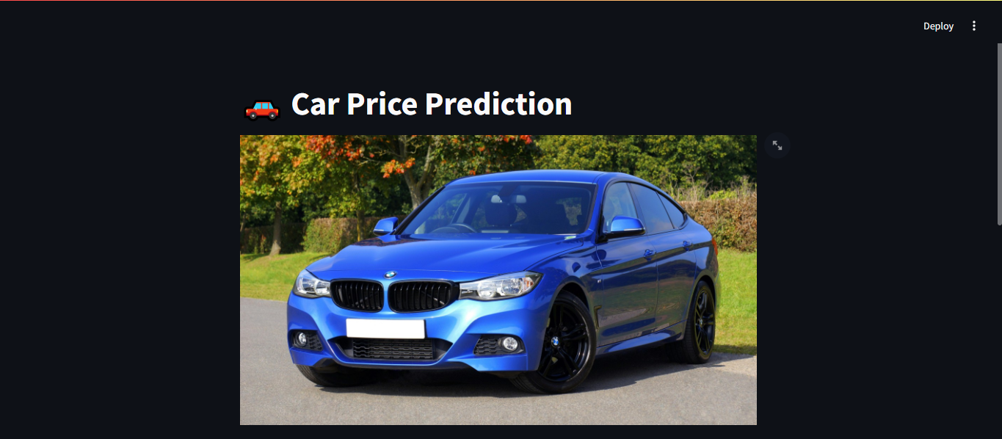
Approach

Slide 20
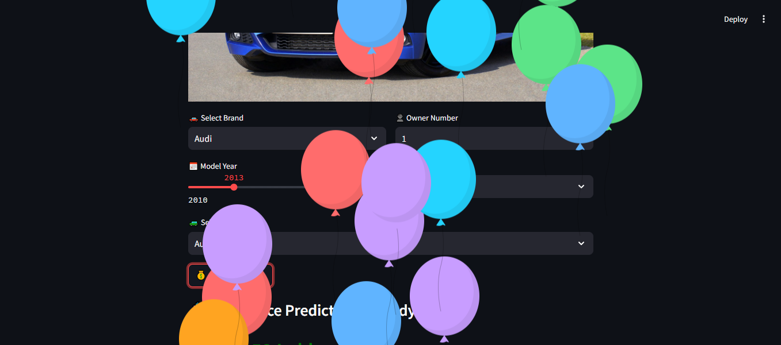
Approach

Slide 21
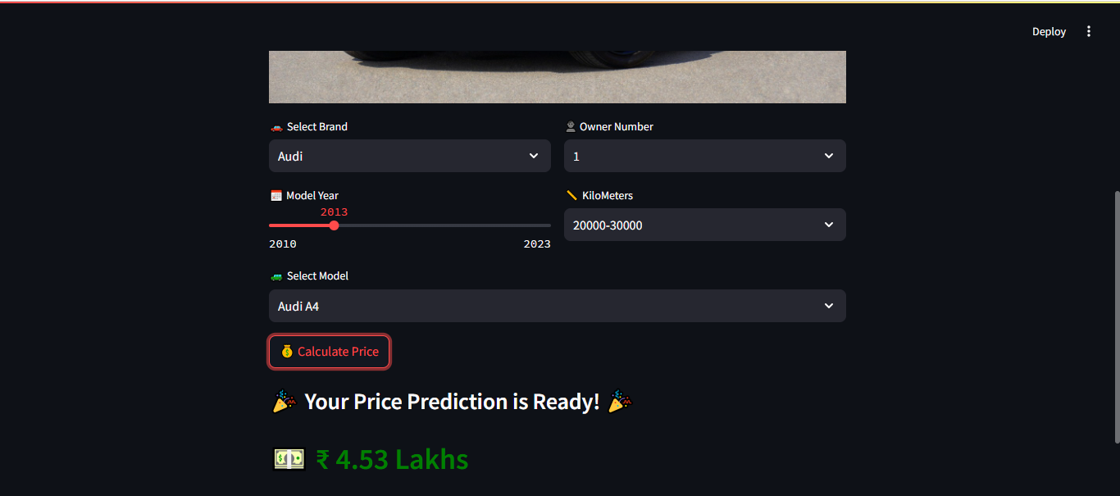
Approach

Slide 22
Thanks!

